Slide 1
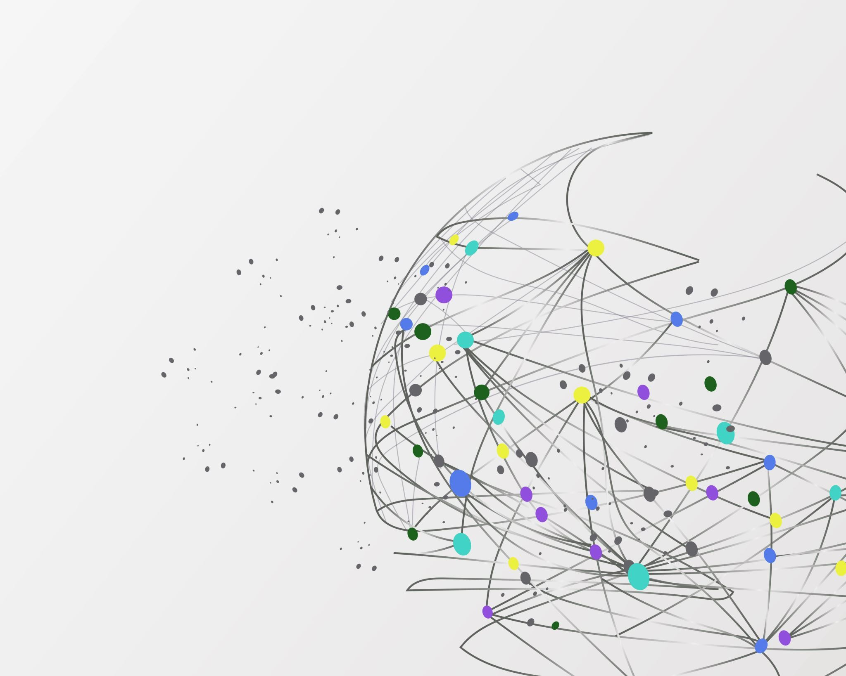
Teacher assessed grades and the student-teacher relationship
Kate Duffy & Alex Brown
Notes:
Aim of sem series
This research unfinished - evoke reflections and enquiry rather than one answer

Slide 2
Aim
Why relations are important (my Phd)
https://sites.google.com/view/pedagogyofrelation/home
Share our interpretation of teacher's narratives
Discuss the possible implications for assessment practice
Notes:
My Phd research opened by interest in relational practice (poor alex has offered to join me in this
recognized that the relational aspects of assessment were under-represented in the literature. In HE we hold the position of teacher and assessor and awarding body and this is unique. It did create dilemmas for me as the affect relations occasionally in the transition (had to work hard at setting expectations and transparency). Generally, the literature was clear on the points above but less clear on the relational aspects of T,LA – arguably because its more difficult to measure and more difficult to standardise

Slide 3
Inquiry
How might the move to teacher assessed grades affect the nature of the Teacher-Student relationship?
Notes:
As the dual role of teacher and 'assessor' in relation to H.S.A. is not usual in our secondary phase of education (and the additional role as moderator, since the reduction of course work and practical aspects of GCSE) became a focus I became curious about the change in relationship here (with a role change, what might the impact be?). Much of the discussion was around the nature of the assessment activity – a wider discussion on allowing the space for authentic and relevant types of assessment and the concern that teachers would be 'qualified' to judge objectively.

Slide 4
Relations in education
It takes two!
Theories of teaching and learning tend to separate teacher activity learner activity
The 4th I for the Ofsted curriculum
Notes:
Why is the student teacher relationship important? Biesta explains that for education to happen it takes two! It takes 2 to tango!
For a long time, education has been understood by the activities that a teacher does and on the other hand the theories to try to understand what the one being educated is (learner activity) is doing
Education is the interaction between the activities of the teacher and the activities of the one being educated.
Between the two is a GAP – many argue that the ultimate aim of education is to narrow the gap between what the teacher can do/knows and what the one being educated knows/can do
The idea that education is the interaction between the activities of the educator and the one being educated sounds fair enough???
We can focus on the activities that each (the one educating and the one being educated) do
However, Biesta asks us to take this ‘interaction’ really seriously and not ignore it.

Slide 5
Mind the Gap!
Biesta, (2010)
The Gap is where the learning happens so we should not ignore it!
The gap is where meaning is made – not transferred or deposited
The 'gap' is where relations happen
Notes:
We have Theories of teaching; Theories of learning –
theory of education (according to Biesta) is the theory of the communicative interaction between the two – what’s going on in the gap?
Its not about the teacher and the learner or the separate activities that they are doing – its about the interaction/relationality between the two
If that is the case, then activities which seek to close the gap, could arguably limit the time and space for education to happen –
If our communicative interaction is to transfer information from teacher to learner then you don’t want the message to change – narrow the gap
Teachers have two options - To negate the gap is to see your task as is to impact directly on the minds of their students – if its not successful then they can blame teacher or student (this is an easy option because it can be controlled and measurable and made to look linear)
Or acknowledge the existence of the gap – this is where meaning making is – if your aim is to craft shared meaning
When we see the practice of education as relational we are accepting that it is a social activity and requires participation. It’s risky for the teacher and the student as but recognises that
The gap makes the opportunity for relation and meaning making happen – cant control the meaning for everyone as their experiences are different

Slide 6
Implications of relations in education
Sidorkin & Bingham (2010, 2022) put forward a 'manifesto of relational Pedagogy' in response the failing neo liberal agendas and the to patch up the traditional/progressive divide.
Elizabeth Campbell (2003), Nel Noddings (2003,2015) Mary Larabee (1993/2016) Carol Gilligan (1982) view relations as integral to ethical and moral practice
Relations in education does not mean that teachers relinquish authority of content or duty, however students can either choose to accept or reject authority of teacher (arguably if the relations is not positive in the gap) (Charles Bingham, 2010)

Slide 7
Teacher Assessed Grades, 2021
Notes:
Introduced as a response to exams being cancelled during the Covid19 pandemic and the government U turn in relation to summer 2020 results.
The intention was that these teacher assessed grades (TAGs) were to be based on evidence produced by the students that could be externally quality assured. Only content that a centre had been able to teach was to be assessed, and a variety of types of evidence could be used to support the holistic judgements centres were asked to make. (Gov, 2022)
See if the shift in power of the judgement (high stakes) is moved from external sources to the teacher, what would happen to the teaching and learning relationship
When high stakes assessment became part of the teaching and learning process during the pandemic, we wanted to capture how the teacher – student was evolving

Slide 8
The research focus
What is the nature of the student-teacher relationship during high stakes teacher assessment of 2021?
What are the lived experiences of teachers in this time of change prior to the assessment and after the assessment?
How can understanding the nature of teacher-student relationships contribute to debate about the future of assessment practice in the UK education system.

Slide 9
Methodology & Method
Titchen & Hobson’s (2011) Direct approach to phenomenology was adopted in order to capture the experience of the teacher in ‘real time’.
More broadly, it is aligned to the work of Van Maanen (1988) and Geertz (2000) in capturing the ‘thick description’ of the ‘critical tales’ from the professional as a way of illuminating the social, the political and relational.
The aim was to understand the phenomena of teacher assessed grades socially, culturally and relationally
Adopted Colnerud's & Alm's (2015) approach to collecting critical incidents in order to foreground the phenomenon through the participants consciousness

Slide 10
Narrative Collection & Interpretation
Collected using Qualtrics programme
Question:
In relation to the teacher assessment which is replacing high-stakes testing in 2020/21 - In what ways do you feel it has affected the nature of the teacher-student relationship? Please draw upon examples if you are able to.
38 contributions gathered in April 2021
23 participants were in roles leading the TAG
31 were teaching post GCSE qualifications (A Level and vocational)
31 had been teaching for more than 6 years.
Researcher transforms these subjective constructions to re-present them more objectively (Titchen & Hobson 2011)

Slide 11
The continuum of relation
Autonomous Demotivation - invested in the process
Role as Teacher - Role as moderator
Ethic of care – ethic of justice

Slide 12
Autonomous Demotivation
Active involvement in assessment

Slide 13
Autonomous Demotivation
Elbra –Ramsay (2021) Explains autonomous demotivation as related to a students sense of self. Students tended to display little effort and motivation with regards to the assessment process, as they displayed a sense of entitlement to the grade.
Cassady & Johnson (2002) found that a moderate level of anxiety with regards to testing and assessment is good as it helps motivate learning. However the use of TAG saw a significant reduction in student anxiety which in turn may have contributed to autonomous demotivation.

Slide 14
Autonomous Demotivation
Although some students felt less need to try as assumed teachers will just give them a high grade.
The students are aware that their exams are being teacher assessed and appear to be quite complacent. The students do not try as hard in the assessments they are asked to complete - the perception being that they will be passed by their teacher irrespective of their results.
Some students have little motivation but maintain expectation of a result because of strength of relationship and past efforts.

Slide 15
Investment in the process
High stakes tests shape much of what is happening in the classroom (Clarke et al 2000)
Assessment directly or indirectly influences students future learning, achievement and motivation to learn. (Moss 2013)
Assessment influences not just what gets taught but how it gets taught (Lucas 2021. pg11). His literature highlights that there is an opportunity to rethink assessment & assessment processes.
Notes:
Bill Lucas – opportunity to rethink assessment.
Educators highlighting there is a focus on teaching to the test during Covid19.
Rethinking assessment wants to strengthen the link between teaching, learning and assessment. When assessment is disjointed – challenge / enjoyment / engagement shifts.
66 pieces of evidence
Teachers noticed students were fully engaged or contrastingly fully invested in the process.

Slide 16
Investment in the process
As long as you are upfront with the students about what is happening along the way, the students are part of the process.
At KS5 pupils are very demanding even to the extent of asking me if I would check their plans for essays on Good Friday so that they wouldn't write an incorrect essay over Easter.
I hope that it supports a more effective relationship giving increased autonomy to both the teacher and the student and increasing self-efficacy

Slide 17
Teacher Moderator

Slide 18
Changing Roles: Teacher as moderator
Teacher
Moderator
No longer ‘just teachers’
The teacher is dependent on the students to produce work to judge and give 'fair' grade.
Focus on assessment at the expense of learning (66 pieces of assessment)
Lack of support from exam boards has increased workload of staff

Slide 19
Changes to the role of the teacher
We are being encouraged to pressure students to attend, creating a more tense and stressful environment, which students don’t react well to.
the pupils expectations are that the teacher will work constantly to help them achieve their grade without thinking about impact on teachers' families
Initially stress was eased as exams were not taking place however once the guidelines around CAG were announced, a lot more work was needed in my own setting. Possibly more than would have been required for exams

Slide 20
Ethic of Care Ethic of Justice

Slide 21
To care or be fair ..
"Students think that those students that 'teachers don't like' are going to receive lower grades".
"I made the decision that our organisation would not use teacher assessment grades this year as felt this would be unfair on students when their circumstances and experiences may have prevented them from passing".
"I feel a sense of guilt towards my students who are studying Functional English as my beliefs are that after months of isolation it is unfair on their mental health to have to carry out an 8 minute presentation"
"I feel that QTAG systems were unfair for those who worked hard all year, some only capable of a Pass. Then awarding body set the Pass bar very low and someone who has not attended or completed anywhere near as much work as the learner who has tried and attended all year, gets virtually the same grade"

Slide 22
https://rethinkingassessment.com/
What may shift this is the PISA test for Creative Thinking
The more authentic and person focuses the assessment becomes the more we need to re-establish their relationships in the classrooms

Slide 23
Bill Lucas
Assessment influences not just what gets taught but how it gets taught (Lucas 2021. pg11)
Teaching & Learning whilst assessment is going on
Re-evaluating what are the actual performances we want students to be good at
Authentic tests have multiple criteria, public and evidenced. Intellectual design features which are enabling and contextualised
Breadth not depth
Standards and grading – cant be on a curve which is what we are used to.
Self assessment becomes more central
Fairness and equity – students can show off their individual abilities

Slide 24
Where to next?
What might the implications for future changes to the process of high stakes assessment be?
Teachers were de-professionalised – all high stakes judgements are external. Systematically moving away from teacher judgement
How can this study help us reflect upon our interactions and relations as part of our curriculum intent, implementation and impact?
Notes:
Questions:
What would be the implications of this if we moved to TAG like Canada & China
Intervention in ITT – pull together the relationship / continum between teaching, learning and assessment.
Rethinking assessment – shift back towards coursework and a range of assessment strategies
Changing the culture of students – self assess – enjoy the process – being in the gap – discomoft but where learning takes place – when we narrow the gap less opportunity for high quality learning.
Do teachers need to learn to live with the gap?

Slide 25
References
Lucas
Tichen & Hobson
Geertz
Van Maanan
Colnerud
Biesta
Sidorkin & Bingham
Campbell
Moss, C. (2013). Research on classroom summative assessment. SAGE Publications, Inc., https://dx.doi.org/10.4135/9781452218649

Slide 26
Context - High Stakes Assessment
What is/was the issue
The main voices and views in the debates on high stakes assessment
Contrast with the assessment in other countries eg China and Cananda where teacher assessment for highstakes assessment is the norm
Bill lucas – wants innovative assessment and authentic assessment
This is going to involve high stakes assessment being part of the teaching and learning process
Authentic and innovative assessment needs to become more dialogic and therefore becomes more relational

